Slide 1
The IMC Planning Process
Chapter 4

Slide 2
Chapter Overview
IMC planning
Selecting markets
  Segments
  Targets
Positioning strategies
Communication objectives
Budget
IMC components

Slide 3
Communication Objectives
Develop awareness
Change beliefs and attitudes
Encourage loyalty
Build customer traffic
Enhance image
Increase market share/sales
Reinforce purchase decisions
Notes:
This is a list of common communication objectives. Most IMC campaigns will emphasize one communication objective, but may accomplish other objectives in the process. There are some logical combinations, such as developing brand awareness and building customer traffic. Increase market share would fit with increase sales and encourage repeat purchase actions. The key is to match the objective to the medium and the message.

Slide 4
The IMC Planning Process
Customers
Current customers
Former customers
Potential new customers
Competitors’ customers
(Segmentation Variables)
Notes:
The customer analysis involves looking at 4 different types of customer groups. The most obvious group is current customers. They will be the easiest to study. But, former customers are important, especially learning why they are former customers and why they switched to another brand. Potential customers is an important group to understand because this may be a primary group to be targeted with an advertising or marketing campaign. The last group is the competitors’ customers. Why do they purchase from the competition and what would it take to get them to switch? In designing ads, it is important to know which group is being targeted. This MTA ad is targeted to individuals who have not yet purchased Mud Trax tires.

Slide 5
The IMC Planning Process
Competitors
Identify:
Sources of info:
Who you will compete with
What are their communication strategies?
Secondary data
Other people
Primary research

Slide 6
The IMC Planning Process
Communications
Examine existing
Brand Positioning
Company communications
Industry communications
  Trade associations, etc.
Competitor communications
Notes:
The 3rd component of the analysis is examining communications. It is important to know what the company is communicating to customers, channel members, employees and other stake holders about the brand. A further focus should be on the communications used in the industry and by competitors. All of this information provides guidance to marketers in developing an integrated marketing campaign.

Slide 7
Market Segmentation
Group with distinct characteristics.
  Homogeneous within
Differs from other segments and population.
  Heterogeneous across
Financially Viable - profitable
Reachable

Slide 8
Why Segment?
Identify company strengths and weaknesses.
Clarifies marketing objectives associated with specific target markets.
Links firm’s strategies and tactics to a specific target group

Slide 9
Target Markets
Benefits sought.
Methods of reaching markets.
Appeals to each market.
Needs not being met.
Demographic and psychographic profile of each market.
Defined by the markets’ needs and interests, not the company’s!

Slide 10
Opportunities
Ignored Customers
Benefits not articulated clearly
Marketing approach
Brand positioning
Where is the competition “failing?”

Slide 11
Segmenting Consumer Markets
Demographics & Psychographics
  Generations
  Geographic
  Geodemographics
Benefits
Usage
F ig. 4 . 2
Notes:
Consumer markets can be segmented, or divided, along a number of dimensions. The most common is demographics because it is the easiest. Other methods used include psychographics, generations, geographic, geodemographics, benefits, and usage.

Slide 12
Demographics - Gender
Female consumers
  Control 66% of spending ($12 trillion)
  Involved in purchasing high-priced electronics (90%)
  Buy and sell stocks (80%)
  Household’s primary accountant (70%)
Notes:
Gender is a common demographic segmentation variable because there are significant differences between males and females and because it is easy to identify each market segment. Men and women purchase different products. They also use the same products, but in different ways. The way marketers communicate to the genders can vary. For instance, females now control about $12 trillion in spending, or 66%. The are involved in product purchases that in the past were dominated by males. For example, 90% of women are involved in purchasing high-priced electronics, 90% deal with financial advisors, 80% buy and sell stocks, and 70% are their household’s primary accountant.

Slide 13

Demographics - Gender
BMW Motorcycle ad directed to men as the primary purchaser and women as the decision-making influencer – not the same message!
Notes:
Through in-depth interviews and focus group research, BMW Motorcycles learned a great deal about differences between men and women when it came to motorcycles. Men were seen as the primary purchaser. They finalized the deal, often appeared to make the final decision. But women were a very important influence on the decision. If the female did not like a particular brand, it was not likely to be purchased. Women were more concerned about comfort, feel, and looks while men were more concerned about the mechanical aspect of the cycle.

Slide 14

Demographics - Age
Target specific age group
Combine with other demographic variables
Children as a group
  Spend $30 billion
  Influence $500 billion
Click on speaker to play ad.
Notes:
Age is another demographic variable that is easy to use for segmentation. Obviously, there is a huge difference in the products children use versus the products adults use. Differences are also present between someone 20 and someone 70. Few marketing messages resonate with all age groups. Therefore, focus on a specific age group. Age segmentation often works well when combined with another demographic variable, such as males ages 20 to 35, or females 18 to 40. One age group that is attractive to marketers is children. They spend $30 billion a year themselves and influence another $500 billion. It is not just toys they influence. Children influence parents on the purchase of everything from food to cameras to furniture to vehicles.

Slide 15
Psychographic Segmentation
Describe consumers’ activities, interests, opinions (AIO)
Combine with demographics to develop target market variables
Notes:
Demographics are relatively easy to identify, but they do not fully explain consumer purchase behavior. Psychographics are an individual’s activities, interests, and opinions. They help marketers to understand why consumers buy what they buy. Psychographics are often combined with demographic profiles to provide a much richer description of a target segment.

Slide 16
Psychographics & Lifestyles
(VALS II)
Innovators – successful, sophisticated, upscale products
Thinkers – educated, conservative, practical value
Achievers – goal-oriented, conservative, career, family
Experiencers – young, enthusiastic, impulsive, social
Believers – conservative, conventional, traditional
Strivers – trendy, fun-loving, peers important
Makers – self-sufficient, respect authority
Survivors – safety, security, focus on needs, price
Notes:
A well-known measurement of psychographics is the VALS2 typology. Consumers are divided into 8 different segments based on their AIO measures (activities, interests, and opinions). This type of information helps marketers design more effective communication. For instance, reaching achievers requires ads that stress careers, families, goals, and a conservative lifestyle. On the other hand, reaching experiencers requires ads to convey youthfulness, enthusiasm, impulsiveness, fashion and social acceptance.

Slide 17
Psychographics & Technology
New Enthusiasts – cutting edge, eager, high incomes/education
Hopefuls – cutting edge, lack financial means
Faithful – not eager, but not averse
Oldliners – not interested in new technologies
Independents – higher incomes, do not value new technology
Surfers – ambivalent about new technology, cynical about business
Notes:
Psychographic profiles have been developed for people as it relates to technology and their use of technology. New enthusiasts are on the cutting edge and eager to try new technologies. They tend to have higher incomes and a higher level of education. Hopefuls want to be on the cutting edge, but lack the resources to purchase new technology, which is often more expensive. Faithful are not eager to embrace new technology, but they are not averse to it either. Oldliners are not interested in new technology and resist changing from what they have. Independents have higher incomes, but do not value new technology. They like things the way they are. Surfers are ambivalent about technology and cynical about business. They see technology as a way for big business to rip you off.

Slide 18
U.S. Consumer’s Segmented by Attitudes Toward Support of Green Marketing
True Blue Green (9%) – Strong environmental values, politically active. Heavy users of green products
Greenback Greens (6%) – Strong environmental values, not politically active. Heavy users of green products
Sprouts (31%) – Believe in theory, not in practice. Buy green only if equal to or superior to non-green products.
Grousers (19%) – Uneducated about environmental issues, cynical about their ability to effect change. Green products are too expensive and inferior.
Basic Browns (33%) – Don’t care about environmental issues or social issues.
Source: Jill Meredith Ginsberg and Paul N. Bloom, “Choosing the Right Green Marketing Strategy,” MIT Sloan Management Review, Vol. 46, No. 1 (Fall 2004), pp. 79-84.
13-18

Slide 19

Demographic & Psychographic
Male Teen Groups
Young metrosexuals – top 25%, outward appearance
Big man on campus
Technosapians
Red-blooded boys
Tuned inward
Under construction
Notes:
Teenage markets have also been described in terms of psychographics. The largest group of teen males is young metrosexuals. They focus on outward appearance and comprise 25% of all teen males. Other groups of teenage males have been named big man on campus, technosapians, red-blooded boys, tuned inward, and under construction.

Slide 20
Demographic & Psychographic
Female Teen Groups
Jockettes – top 25%, enjoy sports, active lifestyle
In-style socialites
Most likely to succeed
Style meets thrift
Traditionalists
Notes:
Teenage females have also been divided into psychographic groups. The largest group, making up 25% of teenage females, is the jockettes. This group has an active lifestyle and enjoys sports. Other female teenage groups are in-style socialites, most likely to succeed, style meets thrift, and traditionalists. By adding psychographic information to demographic data, a much richer understanding of the various teen groups emerge.

Slide 21
Generation Segmentation
Segment | Year of Birth | Characteristics
Generation Y | 1978-1992 | Clothes, autos, college, televisions, stereos
Generation X | 1965-1977 | Focus family and children
Younger boomers | 1954-1964 | Focus family and home
Older boomers | 1945-1953 | Upgrade home, children’s education, luxury items
Seniors | Up to 1945 | Fixed income, health care
Notes:
Markets can be segmented based on generations. This table shows the five major generation groups, when they were born, and primary characteristics of each group. The idea behind generation segmentation is that people who grow up experiencing common events will become similar in their AIO measures. These groups often enjoy the same music, foods, and products.

Slide 22
Geodemographic Segmentation
Combines
  Demographic census data
  Geographic information
  Psychographic information
Potential Rating Index by Zip Marketing (PRIZM)
  62 market segments
    Neighborhood Similarities
Notes:
Geodemographic segmentation combines demographic information, geographic information, and psychographic information. Geodemographic segmentation is beneficial for national firms conducting direct mail campaigns and for retailers in targeting customers in a geographic area around the store. The most well known geodemographic segmentation system is PRIZM. It consists of 62 different market segments. For every zip code in the United States, PRIZM identifies the market segments that reside there. For instance, in downtown Jackson, MS the two primary clusters are southside city and towns and gowns. The southside city cluster contains primarily young and elderly African-Americans, employed in low-paying blue collar jobs, with a lower level of education, who rent apartments, and read sports and fashion magazines.

Slide 23
B-to-B Segmentation
Industry (NAICS/SIC code)
Size of business
Geographic location
Product usage
Customer value

Slide 24
Information Sources
The North American Industry Classification System (NAICS)
Http://www.industrialwhoswho.com/company/naics.cgi
Standard Industrial Classification (SIC)
Http://www.industrialwhoswho.com/company/sic.cgi
The Industrial Who’s Who Web Site
Http://www.industrialwhoswho.com

Slide 25
Product Positioning
Perception
  In mind of consumers
  Relative to competition
Created by factors such as
  Product quality
  Prices
  Distribution
  Image
  Marketing communications

Slide 26
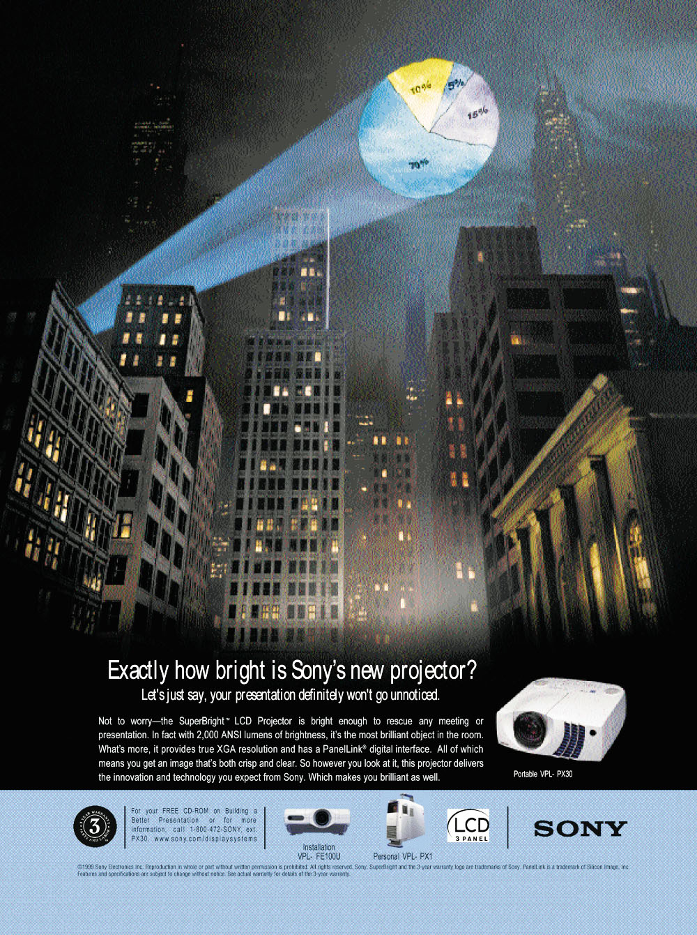

A BtB advertisement positioned by the product’s attributes: the brightness of the Sony projector.
An advertisement by Stetson positioned by cultural symbols.
Notes:
The ad by Sony seeks to position the product based on an attribute – the brightness of the projector light. The advertisement by Stetson is using the American cultural symbol of the cowboy to position its product.

Slide 27
IMC Budget
Budgets based on
  communication objectives
  marketing objectives
Unrealistic assumption to assume direct relationship between advertising and sales
Notes:
The final two steps in the IMC planning process is establishing the communications budget and selecting the IMC components. Both decisions are usually made simultaneously. The marketing communications budget is based on the communication objectives and the marketing objectives. Budgets vary considerably from consumer markets to business-to-business markets. It is unrealistic to expect a direct relationship between budgets and sales. For example, increasing an advertising budget by 25% will not automatically increase sales by 25%.

Slide 28
Factors Impacting Relationship Between Promotions and Sales
Goal of promotion
Threshold effects
Carryover effects
Wear out effects
Decay effects
Random events

Slide 29
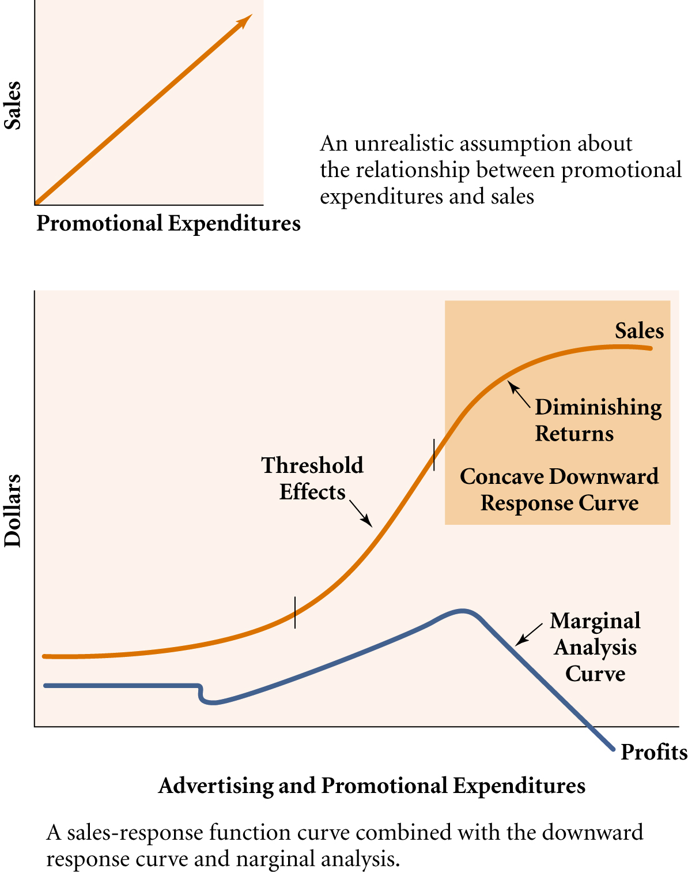
Sales-Response Curve
An unrealistic assumption about the relationship between sales and expenditures

Slide 30
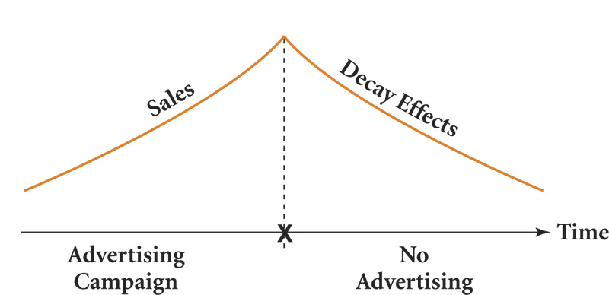
A Decay Effects Model
4-30

Slide 31
Communications Budgets
Percentage of sales
Meet-the-competition
What we can afford
Objective and task
Quantitative models

Slide 32
Promotion Budgets

Slide 33
IMC PLAN BASICS
Executive Summary – Followed by Table of Contents
Integrated Marketing Communications Management
Promotion Opportunity Analysis
Corporate Strategies
IMC Objective 1 (e.g., Consumer Objectives)
IMC Objective 2 (e.g., Channel Objectives)
IMC Objective 3 (e.g., B2B Objectives . . . . )
Media Plan
Evaluation Criteria

Slide 34
I. Executive Summary
The entire plan, abbreviated.
Placed Before Table of Contents
Provides a brief statement of problem, selected solutions, and justification
Reader can find additional details by locating topic in TOC, then go to the body of the report.

Slide 35
  II. Integrated Marketing
  Communications Management
At the “corporate” level
IMC Objectives
IMC Budget
Agency Selection
Internet Web site

Slide 36
III. Promotion Opportunity Analysis
Communications Market Analysis
Communications objectives
Communications budget
  Establish early guidelines
Develop/Prepare promotional strategies
Develop tactical support

Slide 37
III-A. Communications Market Analysis
Competitive Analysis
Opportunity Analysis
Target Market Analysis
Customer Analysis
Positioning Analysis

Slide 38
IV. Corporate Strategies
A. Corporate Image Strategy
B. Brand Development Strategy
C. Brand Positioning Strategy
D. Distribution Strategy
E. Business-to-Business Strategy
F. Public Relations Strategy

Slide 39
Segment Plans
Budget
IMC Methodologies
    Advertising
    Consumer Promotions
    Trade Promotions
    Personal Selling
    Sponsorships
Database Programs
Media Plan
Evaluation Methodology

Slide 40
Integrated Marketing Communications Plan – Structural Outline
Executive Summary
Outline #2-4 occur at the corporate level and apply to all markets. Some included items:
competitive analysis
segmentation analysis and strategy
target market selection
Selection of channels to reach targets
positioning strategy
Corporate Image
Brand Development and positioning
Promotion Mix Strategy (corporate & target)
Total budget
And so on . . . .
Promotion Opportunity Analysis
Corporate-Level Strategies
IMC Management
IMC Objective: Target Market 1
IMC Objective Target Market 2
IMC Objective Target Market 3
Mkt 4, 5,
etc.
The entire plan is summarized into a brief and concise document that presents the major elements of the plan to executive management.
Budget
IMC Methodologies
Advertising
Consumer Promotions
Trade Promotions
Personal Selling
Sponsorships
Database Programs
Media Plan
Evaluation Methodology
Each target market receives an analysis that includes the items in the box at the left. This is repeated for every target market.

