Slide 1
Alternative Marketing
&
Media
Chapter 10

Slide 2
Chapter Objectives
Alternative Media: buzz marketing, guerilla marketing, product placement and branded entertainment
Product placement VS. branded entertainment
Conditions for successful guerilla marketing
Integration of alternative marketing methods

Slide 3
Alternative Media Programs
Requires creativity and imagination
Alternative media programs
  Buzz marketing
  Guerilla marketing
  Product placement
  Lifestyle marketing

Slide 4
Buzz Marketing
Word-of-mouth marketing
  Higher credibility
Fast growth – now $1 billion annually
Methods of generating buzz
  Consumers who like a brand
  Sponsored consumers
  Company or agency generated buzz

Slide 5
Buzz Marketing Stages
Incubation
Infection
Inoculation
Buzz marketing difficult during inoculation stage
Must use brand ambassadors or customer evangelists
True customer-generated buzz occurs after awareness
Awareness generated through traditional advertising
Notes:
Buzz marketing can be compared the stages of a virus: inoculation, incubation, and infection. Inoculation is when the product is being introduced. It is difficult to generate buzz marketing during this stage. Incubation is when the product is being tried by a few innovators and trendsetters. Buzz marketing is easier, but still difficult. Infection is when widespread use of the product begins. The best time for a buzz marketing program. True customer-generated buzz occurs after awareness and often the awareness is generated through traditional media.

Slide 6
Guerilla Marketing
Instant results
    unique, low-cost approaches
Focus on region or area
Create excitement
Involve consumers
Generate buzz
Grassroots efforts
Alternative media

Slide 7
Experiential Marketing
Direct Marketing + Field Marketing + Sales Promotions
Create a set of customer experiences
Concise Segmentation
Direct marketing through interactive connection
Engage consumers
Notes:
Experiential marketing is the intersection of direct marketing, field marketing, and sales promotions. Its basic premise is increasing the experience of direct marketing through an interactive connection. Rather than just pass out samples, make it an experience the consumer will remember. Nickelodeon used experiential marketing with their Slime Across American Tour. 30,000 kids were exposed to the exhibit and 20 million television impressions resulted. Jack Morton Worldwide used a traveling mall exhibit to expose consumers to the benefits of cotton and cotton clothing. Consumers could sing and record their own version of the song “Fabrics of Our Lives.”

Slide 8
Product Placement and
Branded Entertainment
Goal is to increase brand awareness and liking
Placements work best when logical fit
Negative/positive scene impacts reaction
Increase in placement budgets
  Perception of what others think is important to consumers
  Provides postpurchase reassurance

Slide 9
Product Placement
“Advertainment”
Used since 1890s
Surge in 1982 – E.T. and Reese’s Pieces
Increased awareness
More positive attitude toward brand
No immediate impact on sales
Low cost per viewer
  Movies, DVD movie rental,
  TV, Pay-per-view TV
  Video Games
Notes:
Product placement is a planned insertion in a movie, television show, book or other forms of entertainment. It has been used since the 1890s, but only recently has grown in popularity. The biggest surge in product placement came in 1982 with E. T. and Reese’s Pieces. The placement of the Reese’s Pieces in the movie spurred a 65% increase in sales following the movie’s release. Research has found that product placement increases awareness of the brand, creates a more positive attitude towards the brand, but does not have any immediate impact on sales. From a cost standpoint, product placement has a low cost per viewer of impressions. A primary advantage is that the impressions do not stop with the movie. After the movie has played in theaters it goes to DVD movie rentals, to pay-per-view television, then to the movie channels on television.

Slide 10
Product Placement
Nielsen Research
  “Emotionally engaging” TV shows recognized by 43% more viewers
  “Highly enjoyed programs” brand recognition increased 29% compared to 21% for commercial spots
  Positive brand feelings increased 85% compared to 75% for commercial spots.
10-10

Slide 11
Branded Entertainment
Brand woven into the storyline
Use increased sharply with reality shows
Also found in novels, plays, songs, and movies

Slide 12
Alternative Media Venues
Cinema
In-tunnel, subway
Parking lot
Airline in-flight
Leaflets and brochures
Take-out menus
Shopping bags
Clothing
Mall signs/Kiosks
Mobile phones
Video games
Escalators
Airlines

Slide 13
Cell Phone Ads
Growing rapidly ~ $1.6B in 2013
1/3 open to mobile advertising
Types of ads
  Small banner ads
  Click-to-call advertising
  Search ads
Special apps for mobile phones
Notes:
Mobile phone advertising is one of the fastest growing forms of advertising. Currently, it is considered an alternative media, but soon it may become part of mainstream advertising. Only 23% of the population now receives mobile advertising, but another 1/3 are open to the idea of advertising if it will reduce their phone bill. The types of ads sent to mobile phones include small banner ads, click-to-call ads, and search ads. Special apps for mobile phones are also available to consumers, designed to engage consumers with the brand.

Slide 14
Video-Game Advertising
In-game advertisements
Rotating in-game advertising
Interactive ads
Game-related Web sites
Advergames
Sponsored downloads

Slide 15
Video-Game Advertising
$1 billion/year spent on in-game ads
  75% of online households - at least 1 hour/month playing online games
  27% average 30 hours +
Primary market - 7-34 yr old males
    Difficult to reach
    Shooting games
Fastest growing market - females
    Now 20% of market
10-15

Slide 16
Cinema Advertising
Ads prior to movie
Captive audience
Product Introduction Example
  Photosmart Premium Printer – HP
    Cinema center of integrated campaign
    30-second spot in pre-feature program
    17,300 theaters
    2,600 plasma screens in lobbies
    Delivered 50,000 demonstrations
    Delivered 700,000 lobby impressions
Notes:
Cinema advertising occurs prior to the movie. It is a captive audience. Most will watch the ad. HP recently used the cinema to launch its Photosmart Premium Printer. HP had a 30-second spot in the pre-feature programming on all screens in the theaters. It was shown in 17,300 theaters. HP placed 2,600 plasma screens in the lobbies of theaters and delivered 50,000 demonstrations of the printer. Just with the lobby, 700,000 gross impressions were made.

Slide 17
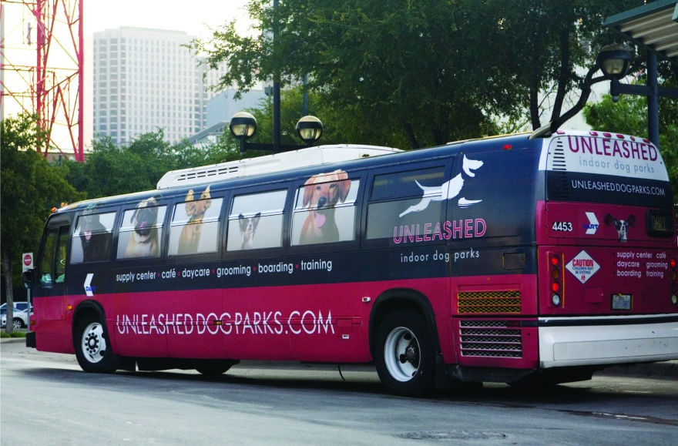
Alternative Media
Bus wrap created by Pink Jacket Creative
Media used were
  Billboards
  Bus wraps
  Street kiosks
Objective –
reach people during routine moments
Notes:
Pink Jacket Creative used alternative media in the advertising of the Unleashed Dog Parks. In Chapter 8, the billboards from the campaign were shown. In addition, Pink Jacket created bus wrap ads and street kiosks. The objective of the campaign was to reach people during routine moments.

Slide 18
In-Store Marketing
70% of decisions made in store
Point of purchase merchandising
In-store atmospherics
  Sight, sound, and scent
Video screens and TV monitors
  Customize messages
  Specialized channels
    Wal-Mart
      ~130 million shoppers per week

Slide 19
Point-of-Purchase Displays
Last chance to reach buyer
  70% of decisions are in store
  50% of $$ spent at mass-merchandisers and supermarkets is unplanned
  Average increase in sales is 9%
Half of POP displays not effective
  Half that are effective – 20% increase in sales

Slide 20
Advertising Influence on Clothing Purchases
Fig. 10-10
Source: Adapted from Amy Johannes, “Snap Decisions,” Promo, Vol. 18, No. 11 (October 2005), p. 16.
Notes:
This graph shows the results of a survey of consumers on what most influenced their clothing purchases. In-store advertising was by far the most influential. The second closest was print ads, at 23.9% versus 52.6% for in-store advertising.

Slide 21
Measuring POP Effectiveness
For retailers
  Indicates time to withdraw or change display
  Identify POP displays with largest impact
  Test market different displays
For manufacturers
  Data can improve quality of displays
  Strengthen relationships with retailers

Slide 22
Effective Point of Purchase Displays
Integrate brand image, current ads and promotions.
Dramatic to get attention.
Versatile - easily adapted by retailers.
Re-usable and easy to assemble, stock.
10-22

Slide 23
Brand Communities
Demonstration of Brand loyalty, devotion
Symbolic meaning
Interactions between brand and consumer
Shared values and experiences
Cannot be created by brands itself
Marketing can enhance community experience

Slide 24
Enhancing a Brand Community
Benefits to encourage new customers
Provide materials not available elsewhere .
Involve firm representatives in the groups.
Sponsor meetings and events.
Promote communications among members.
Build brand reputation.

Slide 25
Sponsored Consumers
Agent or advocate for a new brand
  Apple, Sony, HP, etc.
Brand ambassadors or customer evangelists
  Individuals who already like brand
  Offer incentives in exchange for advocacy
  Selection based on
  Devotion to brand
  Low-cost marketing events
10-25

