Slide 1
Traditional
Media Channels
Chapter 8

Slide 2
Media Strategy
The process of analyzing and choosing media for an advertising and promotional campaign.

Slide 3
Components of a Media Plan
Marketing analysis
Advertising analysis
Media strategy
Media schedule – Timing
  Seasons, events
Justification and summary

Slide 4
People Involved in Media Selection
Media Buyer
Media Planner
Creative
Account
Executive
Client
8-4

Slide 5
Media Planner
People Involved in Media Selection
Create plans that reflect purchase process
Conducts research on audience characteristics
Matches media with target market characteristics

Slide 6
Media Buyer
People Involved in Media Selection
Works closely with media planner
Purchases media time and space
Responsible for media price, quality
    Reach, Frequency
    Cost/ratings point
  Culture and experience important

Slide 7
Media Terms
Achieving Advertising Objectives
Reach
  # in target audience exposed
Frequency
    number of exposures – 4 week period
Opportunities to see (OTS)
  Cumulative exposures
  Placements x frequency
Gross rating points (GRPs)
  Measures impact of intensity of media plan
  “Vehicle rating” x OTS (number of insertions)

Slide 8
Media Terms – Costs 1
Achieving Advertising Objectives
Ref Table 8-1, text
Cost per thousand (CPM)
  Cost to reach 1000 members of vehicle’s audience
Rating
  % of intended target market that is exposed by a particular medium
Ratings and Cost per Rating Point (CPRP)
    Cost of reaching 1% of target market exposed by medium
    Cost of media buy / vehicle’s rating

Slide 9
Media Terms – Costs 2
Achieving Advertising Objectives
Weighted CPM
    Cost of reaching 1000 members of target
Continuity
    Continuous, Pulsating, Flighting campaign
Impressions
  Gross impressions
    total audience exposed to ad

Slide 10
Continuity
Exposure pattern or schedule of the campaign
  Continuous
    Same place, not always the same ad
  Pulsating
    Peaking for holidays, etc.
  Discontinuous (flighting)
    Single season or event schedule

Slide 11
Achieving Advertising Objectives
Three Exposure Hypothesis
Intrusion value
Clutter
Effective frequency and Effective reach
Objective
  Increase brand recognition – visual important
  Increase brand recall – frequency important
Size, placement, length of ad
Number of media used

Slide 12
Achieving Advertising Objectives
Recency Theory
Attention is selective and focused
Impact dissipates over time
Maximize exposure
  Run ads over longer period of time
  Place ads in multiple outlets
Business-to-business
  More outlets, longer period

Slide 13
Traditional Media Selection
Broadcast media
  Television
  Radio
Outdoor
Print media
  Magazines
  Newspapers

Slide 14
Television
Advantages
Disadvantages
High reach
High frequency potential
Low cost per contact
Creative opportunities
High intrusion value
Segmentation possibilities
Clutter, low recall
Channel surfing during commercials
Short amount of copy
High cost per ad

Slide 15
Nielsen Ratings
Measure TV audience
Determines ad rates
Nielsen rating – number of households (out of all possible) that are tuned into a program
Share – number of households with TV on watching a particular program.

Slide 16
Nielsen Ratings
# households tuned to a program
Total #of households in a market
Rating =
In the U.S. the total number of households with TV sets is ~ 109.7 million. To calculate the rating of an episode of American Idol, if the number of households tuned to the season finale was 17.8 million, then the rating would be 16.2
Share
If the advertiser were interested in the percentage of households that actually were watching TV at that hour, the program’s share could be calculated. If 71 million of the 109.7 million households had a television turned on during the hour in which American Idol aired, the share would be 25
Notes:
The cost of TV ads is still determined by Nielsen TV ratings. The ratings are calculated by dividing the number of households watching a program by the total number of households, which in the US is now about 109.7 million. The share is the number of households watching the program divided by the number of households with the TV turned on.

Slide 17
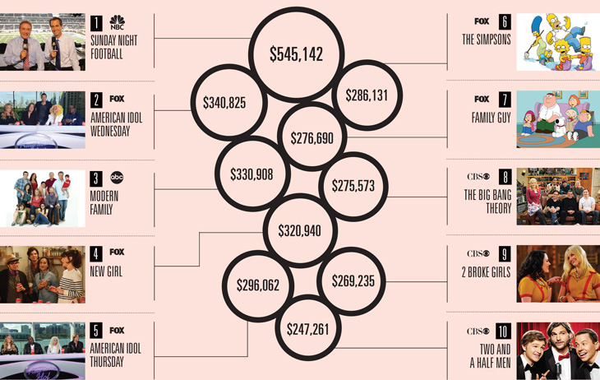
Top 10 Highest priced 30 second ad spots

Slide 18
Local/Regional TV ads
  Excellent for local and regional companies
  National brands – spot TV ads
  Can generate higher regional GRPs at lower costs
Notes:
Local and regional television is excellent for local and regional companies. National brands can advertise on these stations through purchasing spot TV space. About 75% of national time slots are sold during sweeps week. By selecting local channels to supplement the national time, companies can generate higher GRPs at a lower cost. Effective television advertising requires matching the product target audience with a shows viewing audience. Television can reach larger audiences at a lower cost per contact. Cable channels provide opportunities to segment audiences based on interests.

Slide 19

Local/Regional TV ads
A locally produced advertisement for
Matt’s Music Store.
Click on video to play ad.
Notes:
This is a TV ad produced for a local business that ran on a local TV station.

Slide 20
Radio
Advantages
Disadvantages
Low cost per spot
Low production cost
Use of music
Segmentation potential
Flexibility in making and modifying ads
DJ intimacy
Mobility
Short exposure time
Low attention
Poor national audience capability
Target duplication in many areas

Slide 21
Outdoor
Advantages
Disadvantages
Large ads
Select areas
Accessible for local ads
Low cost per impression
Broad reach
High frequency
Legal limitations
Short-exposure time
Brief message
Limited segmentation
Cluttered travel routes

Slide 22
Magazines
Advantages
Disadvantages
High segmentation
High color quality
Long life
Direct response techniques
Read during leisure
Longer attention to ads
Long lead time
Little flexibility
High cost
Clutter
Declining readership

Slide 23
Newspapers
Advantages
Disadvantages
Priority to local ads
Coupons and special response ads
High credibility
Strong audience interest
Longer copy
High flexibility
Cumulative volume discounts
Clutter
Short time span
Poor quality reproduction
Limited audience
Poor national buying procedures

Slide 24
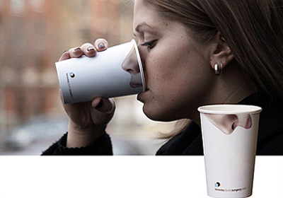
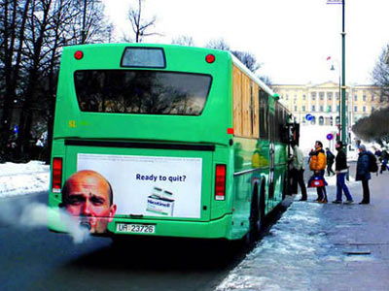
Alternative Media
Package insert programs (PIPs)
Ride-a-longs
Statement stuffers
Card packs

Slide 25
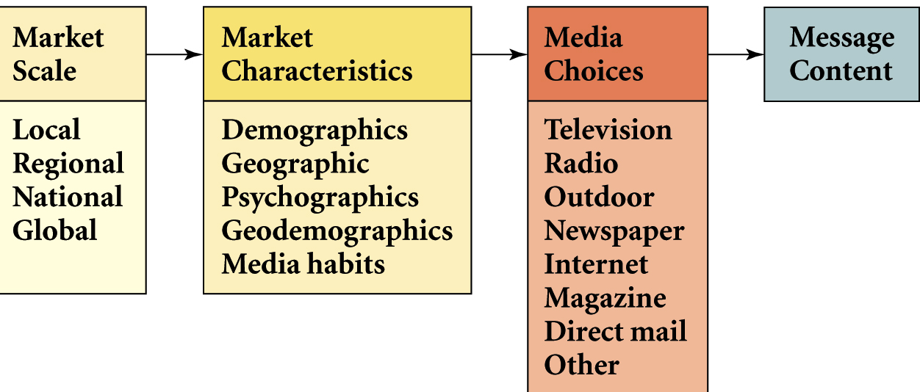
Developing Logical Combinations of Media – Fig 8.9
Notes:
Developing logical combinations of media takes planning. It starts by deciding the scale of the media market – local, regional, national, or global. Next comes an understanding of the market characteristics – demographics, geographic location, psychographic profile, and media habits. From this information decisions can be made about which media is the best – TV, radio, outdoor, newspaper, magazines, direct mail. Last, comes the content.

Slide 26
Media Spending

Slide 27
B-to-B Advertising
Shift in media buys
  Approximately half of all b-to-b ad dollars are in non-business environments
Reasons for shift
  Business decision makers are consumers.
  Business decision makers are difficult to reach at work.
  Clutter among business outlets.

Slide 28
Media Selection
International Markets
Media importance varies
Media viewing habits vary
Media buying is different
Cultural mores vary

Slide 29
Hypothetical Media Information
for Select Magazines
 |  |  |  | Target Market (20 Million)
 | 4-Color Full-Page Ad | Reader-ship | CPM | % of Readers Fit Target | # of Readers Fit Target | Rating (Reach) | (CPRP)
Glamour | $842,658 | 18,354,000 | $45.91 | 13.51% | 2,480,000 | 12.4 | $67,956
National Geographic | $346,080 | 21,051,000 | $16.44 | 16.25% | 3,420,000 | 17.1 | $20,239
People | $605,880 | 21,824,000 | $27.76 | 6.87% | 1,500,000 | 7.5 | $80,784
Southern Living | $11,370 | 5,733,000 | $1.98 | 10.81% | 620,000 | 3.1 | $3,668
Sports Illustrated | $965,940 | 13,583,000 | $71.11 | 12.96% | 1,760,000 | 8.8 | $109,766
Time | $1,324,282 | 21,468,000 | $61.69 | 11.65% | 2,500,000 | 12.5 | $105,943
Travel & Leisure | $183,216 | 2,205,000 | $83.09 | 12.70% | 280,000 | 1.4 | $130,869
Fig 8-1
Notes:
This table provides hypothetical media information for select magazines. The CPM is calculated by dividing the cost by the total readership then multiplying by 1,000. For this example, the target market consists of 20 million. The fifth column identifies the percent of the readership that fits the target market. For example, 13.51% of Glamour’s readership fits the target market of this product. The next column is the 13.51% times the total readership for Glamour, which means 2.48 million readers of Glamour fit the target audience for this product. The rating (reach) is the number of readers who fit the target market divided by the total market (20 million). For glamour the 2.48 million was divided by 20 million yielding a reach of 12.4, or 12.4%. Thus, 12.4% of the target market reads Glamour. The cost per rating point is the cost of the ad divided by the rating. For Glamour it is $842,658/12.4.

Slide 30
Ad Math
1
1) Magazine A has a cost for a full-page ad of $10,000 and a circulation figure of 5,000,000. Of these 5,000,000 subscribers, 40 percent are tennis buffs. Magazine B has a cost for a full page ad of $12,000 and a circulation of 3,000,000. Of the 3,000,000 subscribers, 75 percent are tennis buffs. If you sold tennis racquets and were comparing the weighted CPM (also referred to as target market CPM – TCPM) of these magazines, which would you choose to advertise within (if you could choose only one)?
A) Magazine A
B) Magazine B
C) Magazine A would be just as effective as Magazine B
D) More information is needed on audience size
E) More information is needed on costs

Slide 31
Ad Math
2
TCPM = Cost of media buy / actual audience
For Magazine A:
TCPM = 10,000 / (5,000,000 X .40) = 5
Market reached = 2,000,000
For Magazine B:
TCPM = 12,000 / (3,000,000 X .75) = 5.333
Market reached = 2,250,000

Slide 32
Ad Math
3
2)Ads on a TV station will be run 100 times over the next month. We estimate that 60% of the stations total audience will be exposed to this ad. 50,000 households, or 30% of those exposed, will be within our target market. How big is waste coverage in this case?
A) About 117,000 households.
B) About 67,000 households.
C) About 125,000 households.
D) About 15,000 households.
E) Cannot say until we know how big the audience actually is.

Slide 33
Ad Math
4
Households reached = 50,000 / .30 = 166,667 households
Waste Coverage = Total Coverage X unintended audience
= 166,667 X .70 = 116,667

Slide 34
Ad Math
5
3) Our awareness objective is to obtain awareness in 120,000 households. We estimate that with 90 TV ads run over 30 days, we can obtain 80,000 targeted households aware. With publicity associated with a special event, we can obtain another 45,000 households aware of us. We estimate that 20 percent of the target households who see the ad will also see the publicity for the event. The cost for producing the TV ad is $20,000. The cost for placement is an average of $3,500 each time the ad is run. For publicity, a month's retainer is $15,000 and we need three months' effort in obtaining publicity. It also costs $150,000 to run the event. Which medium has the higher targeted CPM (you don't need to consider duplication)?
A) TV has a higher TCPM.
B) Publicity has a higher TCPM.
C) The two are the same.
D) TV is always higher cost, no matter what the TCPM.
E) We do not have enough information -- we need information regarding the quality of the ads.

Slide 35
Ad Math
6
Cost of TV:
20000 + (90)3500 = $335,000
TV TCPM:
335,000 / 80000 = 4.1875
Cost of PR:
15000(3) + 150000 = $195,000
PR TCPM:
195000 / 45000 = 4.33

Slide 36
Ad Math
7
4) Our awareness objective is to obtain awareness in 120,000 households. We estimate that with 90 TV ads run over 30 days, we can obtain 80,000 targeted households aware. With publicity associated with a special event, we can obtain another 45,000 households aware of us. We estimate that 20 percent of the target households who see the ad will also see the publicity for the event. The cost for producing the TV ad is $20,000. The cost for placement is an average of $3,500 each time the ad is run. For publicity, a month's retainer is $15,000 and we need three months' effort in obtaining publicity. Will we reach our objective of 120,000 households aware of us?
A) No, we will miss it by 11,000
B) No, but we don't know how far off we will be
C) No, we will miss is by 19,000
D) Yes, we will be 5,000 over the objective
E) Yes, we will be at exactly 120,000.

Slide 37
Ad Math
8
80,000 - 20% = 64000
64000 + 45000 = 109000
120000 - 109000 = 11000

